Slide 1
Advanced Topics in SQA
CH06: Software Risk Management And Audits
Course Instructor: AMIR IMAM

Slide 2
What is Risk
“Risk is the probability of suffering Loss or Gain while pursuing goals due to factors that are unpredictable or beyond control.”

Slide 3
A Boundary Problem
Local issues are not regarded as Risk.
It may be termed as Internal Risks that can be solved by taking internal measures.
Mostly internal risks are regarded as dependency risks that are solved by better Coordination and risk communication.
Some Internal Risks arise because of lack of Process Capability.
When an organization is divided, more boundaries appear and employees see more internal risks.
When the organization is integrated, internal risks are called Process Management Issues.

Slide 4
A Boundary Problem
External conditions are beyond our control.
There are risk factors beyond our sphere of influence.
Examples:
Competitors cut down prices.
Social forces may erode staff loyalty.
The PM sees external risks as threats and develops strategies to deal with them
Example: The requirements keep changing; they “creep.”

Slide 5
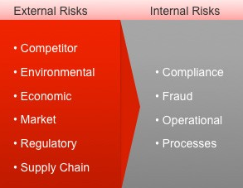
A Boundary Problem
Internal Risk is the probability of suffering losses while pursuing performance and growth goals because of inadequacies in process capability and organizational structure.
External Risk is the probability of suffering loss while pursuing performance and growth goals because of uncertainties in external conditions.

Slide 6
Expressing Risk: The Basic Terms
Risk culture also thrives on clear definitions of risk terms.
Risk ID: A unique reference number given to each risk for traceability.
Risk Probability: The probability of risk occurrence.
Risk Impact: The level of damage if risk occurs.
Risk Exposure: The combination of risk probability and risk impact.
Risk Origin: Source of risk (internal or external).
Risk Category: A group or class with a set of similar risks.
Risk Owner: Process owner whose objectives are likely to be harmed by risk.

Slide 7
Risk Attributes
Attribute | Classes
Origin | Internal or External
Domain | Project/Process/Product or Business/Technical
Nature | Hazard/Constraint/Nominal/Trivial
Affected (key result area) | Cost/Schedule/Quality/Performance
Attack Time | Immediate/Quarterly/Yearly
Speed | Slow or Fast
Level | Process/Project/Program/SBU/Enterprise
Affected Process Area | Requirement/Design/Coding/ Testing Training management/Facilities management/Quality Management/Project Management
SEI Taxonomy | Product Engineering/Development Environment/Program Constraints
Visibility | Low/Medium/High
Affected Goals | Goal 1/ Goal 2/ Goal 3 …
Affected requirements | REQ 1 / REQ 2 /REQ 3 …

Slide 8
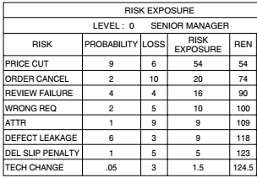
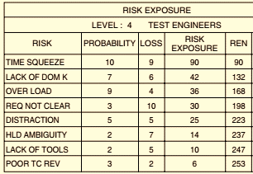
Risk Scale – Case Study
The total REN value in the first assessment is 124.5.
In the second assessment, it is 253.
Can we conclude that the test engineer estimate double the risk intensity compared to a senior manager? We cannot say that with confidence, these are different.

Slide 9
Risk Management Process
Risk Identification
Risk Analysis and Assessment
Risk Response
Risk Monitoring and Control

Slide 10
Risk Identification
We have to recognize the risks from hidden locations, name them, define them, and assign attributes from a risk classification system.
Need to search all processes, and consider all factors.
Position the risk in the correct Risk Level.
We have to review the consequence of the Risk and Rank it.
Definition : “Risk identification is the process of searching the environment, detecting risks, recognizing their attributes, and estimating their consequences”

Slide 11
Risk Identification Methods
Type I (generic, open-ended)
Intuitive Methods
Mind Mapping
Brainstorming
Out-of-Box Thinking
Analogy
History Based Methods
Top ten Risks
Risk Checklist
Taxonomy based Questionnaire
Type II (formal)
Context Setting
Data Gathering
Risk Discovery
Attribute Assignment
Validation
List

Slide 12
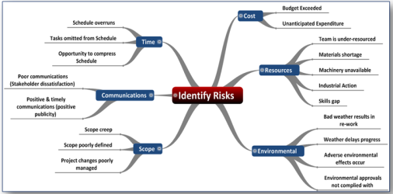
Type I: Intuitive Methods
Mind Mapping
The mind recognizes risk symptoms by mapping familiar symptoms.
Sometimes, the mapping is based on lessons learned.

Slide 13

Type I: Intuitive Methods
Brainstorming
Invite Team
Explain the objective
Set a Time Limit
Encourage Ideas for identification
Prepare basic Risks list
Filtering, Classifying and Clarifying
Finalized Risk List.

Slide 14

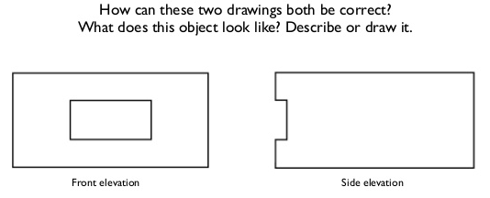

Type I: Intuitive Methods
Out-of-the-Box Thinking
We can see risks better if we stand out of the box and take an external and holistic perspective of the situation.

Slide 15
Type I: History-Based Methods
Caper Jones approaches risk management like managing diseases
That “risk lists” demonstrated by Rex Black’s “Critical Testing Processes.”
CAPER JONES
1. Artificial maturity levels
2. Canceled projects
3. Corporate politics
4. Cost overruns
5. Creeping user requirements
6. Crowded office conditions
7. Error-prone modules
8. Excessive paperwork
9. Excessive schedule pressure
10. Excessive time to market
REX BLACK’s
1. Functionality
2. Load, capacity, and volume
3. Reliability/stability
4. Stress, error handling, and recovery
5. Date and time handling
6. Operations and maintenance
7. Data quality
8. Performance
9. Localization
10. Compatibility
11. Security/privacy
12. Installation/migration
13. Documentation
14. Interfaces

Slide 16
Risk Analysis
Definition : “The purpose of risk analysis is to understand risks better, and to verify and correct risk attributes.”
Definition : “The purpose of risk analysis is to select risks for mitigation.”

Slide 17
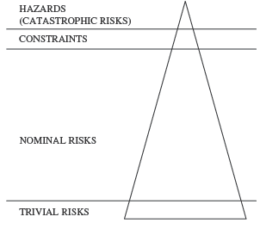
Screening the Risks
Hazard Risks (catastrophic risks, or killer risks): are those with highest impact on the project. They have the potential to cause maximum damage.
Solution: Murphy’s law (Go by the wise advice: if something can wrong, it will). If we take hazard risks, we must have a good reason for doing so. There must be great returns with continuous risk monitoring and special early-warning systems to detect signals much before the catastrophe occurs.
Constraints: 100% percent probability of occurrence.
Solution: The project runs within these constraints. System Management or Project Management approaches will be used to handle such constraints.
Normal Risk: Having normal impact on project.
Solution: Calculate Risk and Prioritized using the Pareto law: 20 percent of risks account for 80 percent of exposure.
Trivial Risk: Very low impact (negligible) on project.
Solution: The trivial risks are kept aside.

Slide 18
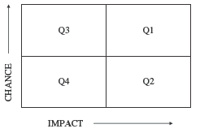
First-Order Analysis: Quadrant Map
Quadrant Mapping helps in getting a bird’s eye view of risks and responding to critical risks first.
Risks are represented in four quadrants in a two-dimensional chart showing Impact in the X-axis and Probability in the Y-axis.
Quadrant I: High-Impact High-Probability Risks
Quadrant II: High-Impact Low-Probability Risks
Quadrant III: Low-Impact High-Probability Risks
Quadrant IV: Low-Impact Low-Probability Risks

Slide 19

First-Order Analysis: Quadrant Map
Some people use a 10 by 10 grid analysis, which is a refinement over quadrant analysis.
The X-axis represents Impact on a scale 0 to 10.
The Y axis represents probability of risk in a scale 0 to 10.
Each grid location has a specific risk value: location 1 by 1 is the lowest, 5 by 5 medium, and 10 by 10 the most critical problem.
Probability (0 - 10)
Impact (0 - 10)

Slide 20
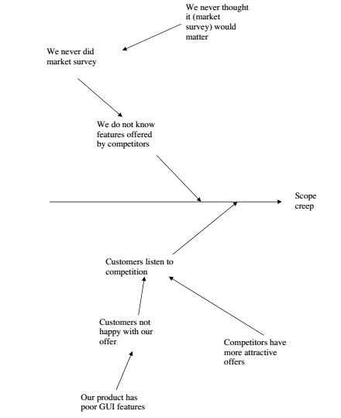
Second-Order Analysis: Causal Analysis
Risk: Scope Creep
1. Cause: Customer listens to competitors
1.1 Sub Cause: Customers are not happy with our offer.
1.1.1 Root Cause: Our product has poor GUI features
1.2 Sub Cause: Competitors have more attractive offers.
1.2.1 Root Cause: No idea
2. Cause: We do not know features offered by competitors
2.1 Sub Cause: We never did market survey.
2.1.1 Root Cause: We never thought it would matter

Slide 21
Ownerless Risks
It is possible that the risk log does not contain the risk owner’s name.
That is because nobody owned the risk, or was willing to own it.
Absence of risk owners is equivalent, in effect, to absence of process owners.
This issue must be “escalated” to higher management.
Analysis of ownerless risks is not a profitable endeavor.

Slide 22
Risk Response Plans
Risk response is the process of controlling identified risks. Risk response is a planning and decision making process whereby stakeholders decide how to deal with each risk.
Negative:
Avoid: Change your strategy or plans to avoid the risk or removing route cause.
Mitigate: Take action to reduce the risk by reducing chance or impact.
Transfer: Change the owner of risk.
Positive:
Share: Distributing the risk across multiple partners, teams or projects.
Enhance: Enhancement is an action that is taken to increase the chance of the risk occurring.
Exploit: Exploiting a risk is to make use of resources that become available if the risk occurs. For example, if a task finishes early, you plan to reassign the resource to more work.
Accept: Decide to take the risk. (Active, Passive)
Contingency: Making plans to handle the risk if it occurs (Plan B).

Slide 23

Positive Risk Response Example
Customer offered 20,000$ bonus if the program coding is completed two months earlier than planned.
Exploit: Allocate a Senior Programmer
Enhance: Train your Programmer
Share: Contract the program coding
Accept: Do Nothing

Slide 24

Negative Risk Response Example
Adventurous trip to go swim with sharks and take exotic photos, deadly shark attack has been identified as main threat for this trip.
Avoid: Rent a metal cage
Mitigate: User shark baits
Transfer: Hire a professional
Accept: Take a spear gun or doing nothing

Slide 25
 | Risk Identification | Risk Analysis | Risk Response Plan | Risk Monitoring and Control
Inputs | Project Charter Project Scope Statement Project Plan Historical Information Lessons Learned | Identified Risks Work Performance information | Prioritized Risks Project Plan | Work Performance Change Requests Project Plan Ongoing Risk Analysis
Tools & Technologies | TYPE I Intuitive Mind Mapping Brainstorming Analogy Out of Box History Based Top Ten Risks Checklist Questionnaires TYPE II (Formal) | First Order Analysis Risk Screening Quadrant Map Top Ten Risk List Risk Distribution Internal-External Project – Product – Process Second Order Analysis Time and Causal Analysis Process and Performance Area Map | Negative Avoid Transfer Mitigate Positive Share Enhance Exploit Accept (Active, Passive) Contingency Plan | Risk Reassessment Risk/Project audits Variance and Trend analysis Performance measurement Reserve management
Output | Identified Risks Project Plan Updates | Prioritized Risks | Risk Response Plan Contingency Reserve Project Plan Updates | Corrective actions Workaround plans Project plan updates Update Risk Response Plan Lessons learned

Slide 26
# | Date | Risk | Probability of Occurrence (H/M/L) | Impact (H/M/L) | Expected Value (H/M/L) | Response Actions Action By – Target Date | Status
1 | 04/15/18 | Vendor may not deliver application software on time
2 | 04/15/18 | Subject matter experts may not be available on dates planned
3 | 04/15/18 | Snowstorm may prevent cutover team from working on site
4 | 04/15/18 | Server capacity may not support the planned number of users
5 | 04/15/18 | Client may change requirements causing delay in cutover

Slide 27
# | Date | Risk | Probability of Occurrence (H/M/L) | Impact (H/M/L) | Expected Value (H/M/L) | Response Actions Action By – Target Date | Status
1 | 04/15/18 | Vendor may not deliver application software on time | H | H | H
2 | 04/15/18 | Subject matter experts may not be available on dates planned | L | L | L
3 | 04/15/18 | Snowstorm may prevent cutover team from working on site | L | H | M
4 | 04/15/18 | Server capacity may not support the planned number of users | M | M | M
5 | 04/15/18 | Client may change requirements causing delay in cutover | M | H | H

Slide 28
# | Date | Risk | Probability of Occurrence (H/M/L) | Impact (H/M/L) | Expected Value (H/M/L) | Response Actions Action By – Target Date | Status
1 | 04/15/18 | Vendor may not deliver application software on time | H | H | H | Establish a penalty clause in the contract with the vendor . JR – 4/18/18
2 | 04/15/18 | Subject matter experts may not be available on dates planned | L | L | L | (No need to address since Expected Value is “Low”)
3 | 04/15/18 | Snowstorm may prevent cutover team from working on site | L | H | M | Arrange for key team members to stay in a nearby hotel. BD – 4/20/18
4 | 04/15/18 | Server capacity may not support the planned number of users | M | M | M | Arrange for extra server capacity to be installed JR – 4/21/18
5 | 04/15/18 | Client may change requirements causing delay in cutover | M | H | H | Establish a “freeze” date, with any changes applied to a future release LK – 1422/18

Slide 29
Quality Audits
“A systematic and independent examination to determine whether quality activities and related results comply with planned arrangements, and whether these arrangements are implemented effectively and are suitable to achieve objectives“
GOAL: To collect objective evidence to permit an informed judgment about the status of the systems or product being audited

Slide 30
Basic Types of Quality Audits
Internal (First Party, Self): This type includes audits by company employees, consultants and contractors to its own company.
External (Second Party, Third Party):
Supplier Audit (Second Party):
Customer employee(s) audit your company or
Your employee(s) audit a company which supplies your company with a product or service
Independent Organization(Third Party Audit)
A customer wants an audit of your company

Slide 31
Audit Sub-Types
Compliance (do we comply with the standard)
Example: Desk audit of high level systems
System (the theory)
Example: Audit of Document Control
Process (the practice)
Example: Audit of any process (manufacturing)
Product (the result)
Example: Audit of finished products to fulfill technical specifications

Slide 32
Who Perform an Audit
(A) Imposed Upon Manufacturer and Supplier
Regulatory
Customer or Potential Customer
Third Party on Behalf of Customer

Slide 33
Who Perform an Audit
(B) Performed by Manufacturer
(i) Internal Self Inspection
(ii) External

Slide 34
Reason of Quality Audit
INTERNAL:
in order to
Determine the level of compliance
Build confidence (hopefully) in the QA system
Build interdepartmental trust, understanding, and communication
Determine measures necessary to improve, e.g.,:
Premises, equipment, environment
Operations, actions, procedures
Personnel/training
Provide a stimulus for improvement
Recommend corrective action (CAPA)
Monitor improvement

Slide 35
Reason of Quality Audit
EXTERNAL:
in order to
Establish and monitor capability of supplier or contractor to deliver Goods and services that are fit for purpose (and on time, and in the quantity required)
Build mutual confidence.
Promote understanding and communication between the parties involved
And in general, as listed for “internal”

Slide 36
Quality Audits Steps
Plan and Prepare
Arrange and Announce
Arrive at site, meet, explain purpose
Perform Audit
Informal oral reporting finding
Formal reports with recommendations
Follow-up

Slide 37
Process Audits
examination of
1. established methods
2. instructions
3. work flow for processes
4. maintenance programs for production equipment
5. material handling
6. housekeeping around the work area

Slide 38
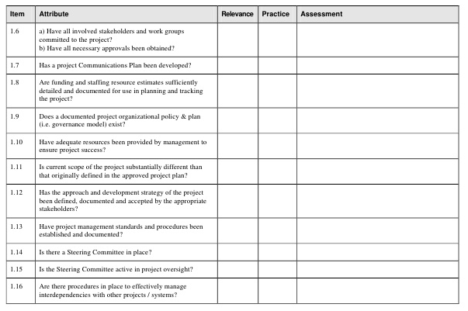
Typical Checklist for Quality Audits

Slide 39
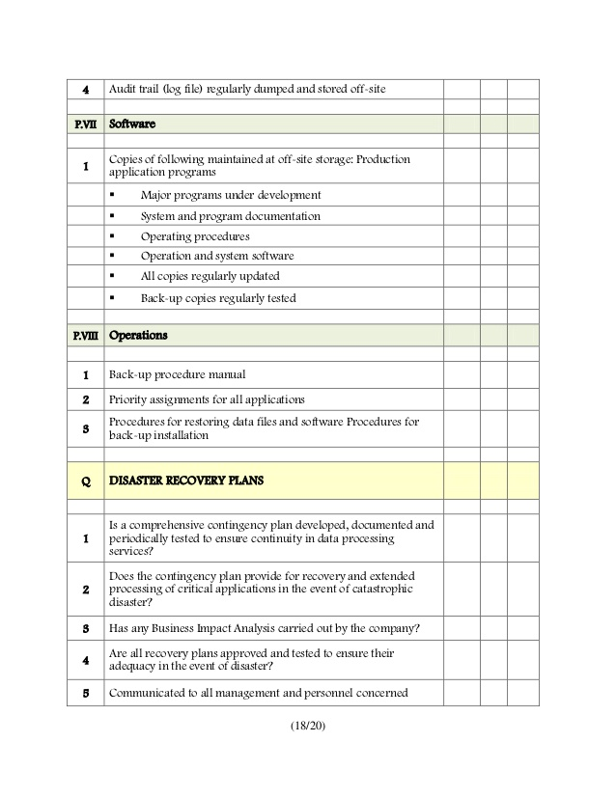
Typical Checklist for Quality Audits

Slide 40
Any Question?
End!

